Slide 1

Foodie App
Presented by
Harshil Mehta
Ishita Rawat
Aditya Ranjan

Slide 2
Foodie App
In This App User will be able to register. A registered user will be able to login.
User can Search for restaurant and cuisine based on the location.
User can be able to add his favourite restaurant or cuisine.
User can View all favourite restaurants and cuisines under favourite section.

Slide 3
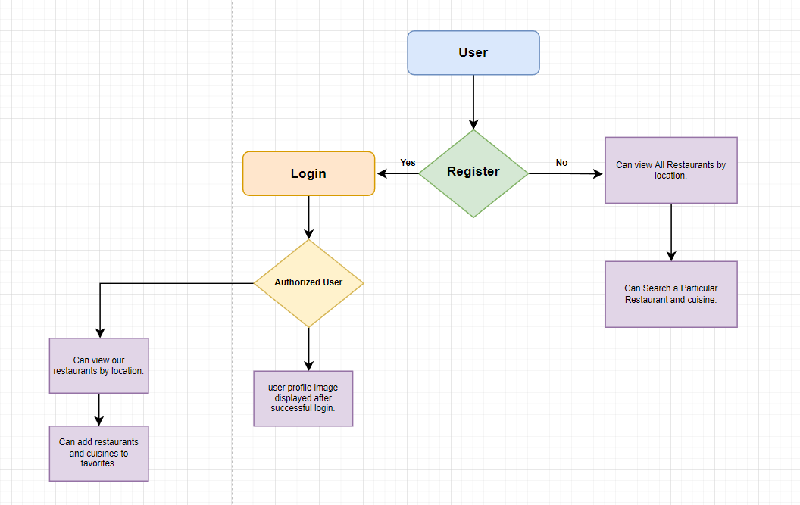
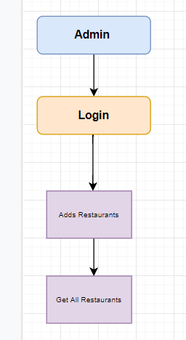
Workflow diagram

Slide 4
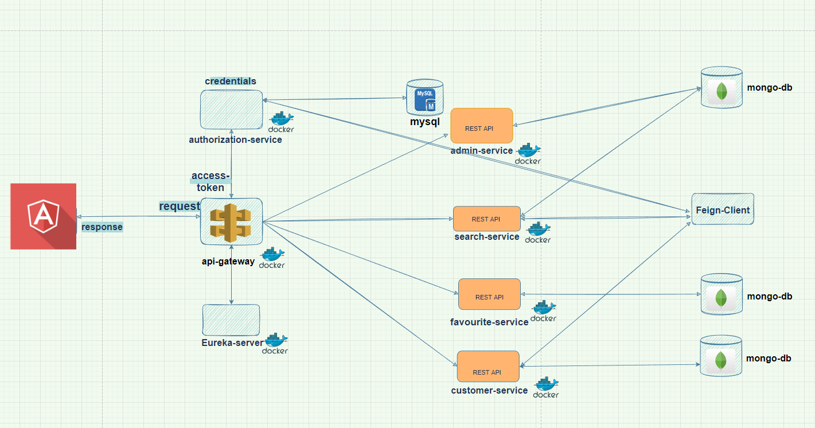
Architecture diagram

Slide 5








Technologies Used

Slide 6
Features we have implemented at Backend
API Gateway Service
Eureka Server
Feign Client
Docker
JWT Token
Docker Compose

Slide 7
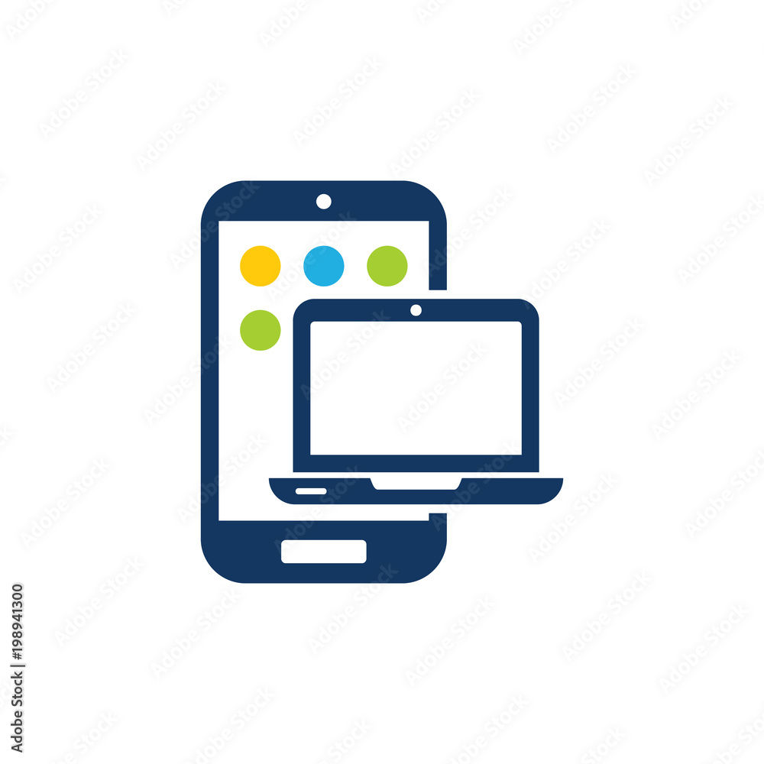
API Gateway Service
Admin Service
Authorization Service
API Gateway Service
Customer Service
Search Service
Favorite Service

Slide 8
API Gateway
An API Gateway sits between clients and services and a single entry point for all clients requests.
It takes all requests from clients and then routes them to the appropriate microservice with request routing, composition and protocol translation.

Slide 9

Eureka Server
Service discovery is the process of one service dynamically discovering the network location (IP address and port) of another service to communicate with it.
Eureka is a REST based service which is primarily used for acquiring information about services that you would want to communicate with. This REST service is also known as Eureka Server. The Services that register in Eureka Server to obtain information about each other are called Eureka Clients.

Slide 10

Docker
Docker is a container technology used to build, ship, and run any app, anywhere.
Docker helps separate applications from the infrastructure so that a software can be delivered quickly.
Using Docker methodologies for shipping, testing, and deploying a code can significantly help reduce the delay caused during writing a code and running it in production.

Slide 11

Docker Compose
Docker Compose is used for running multiple containers as a single service.
Docker Compose files are very easy to write in a scripting language called YAML.

Slide 12
Microservices
Admin Service
Authorization Service
Customer Service
Search Service
Favourite Service

Slide 13
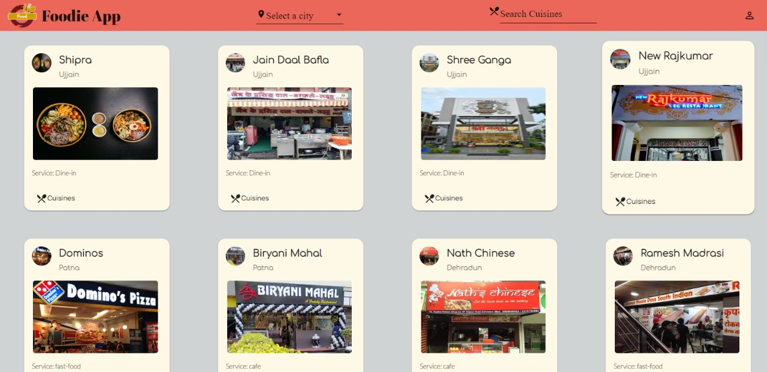
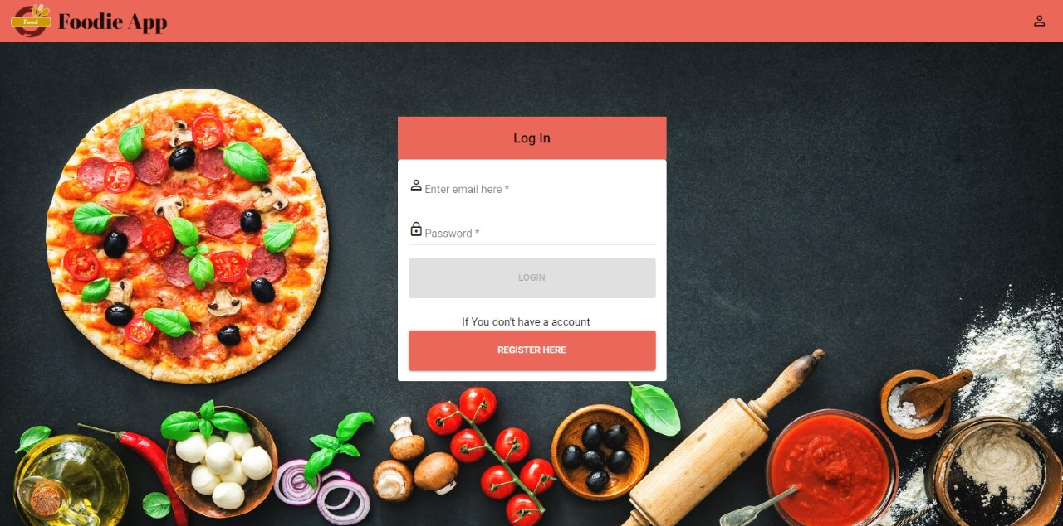
Output Screenshots

Slide 14
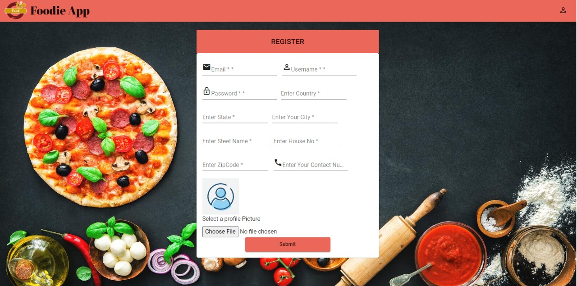
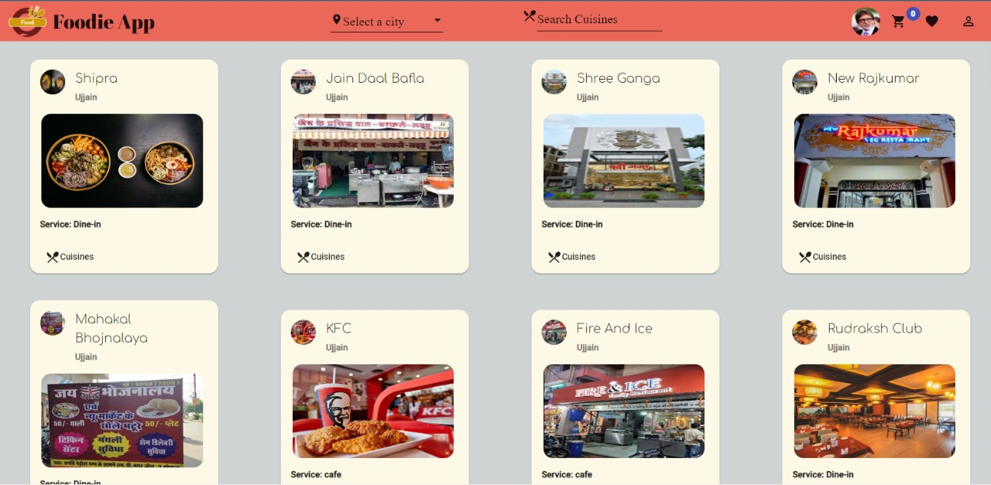
Output screenshots

Slide 15
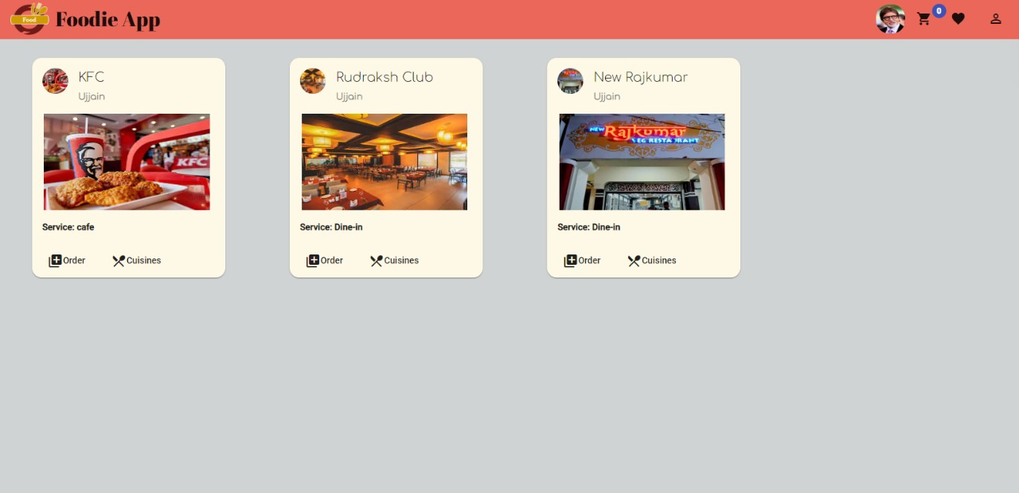
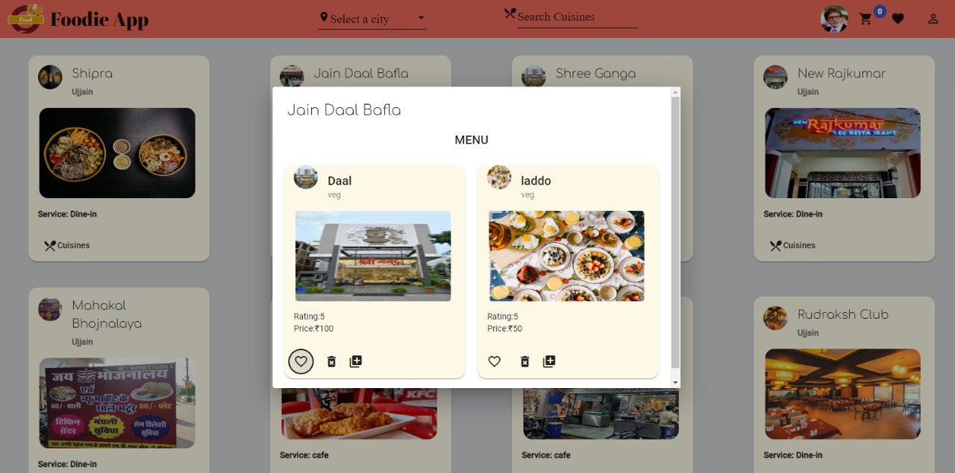
Output screenshots

Slide 16
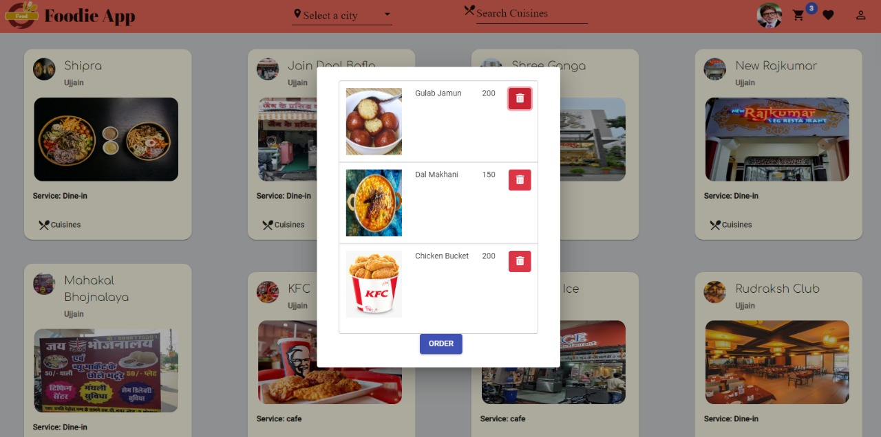
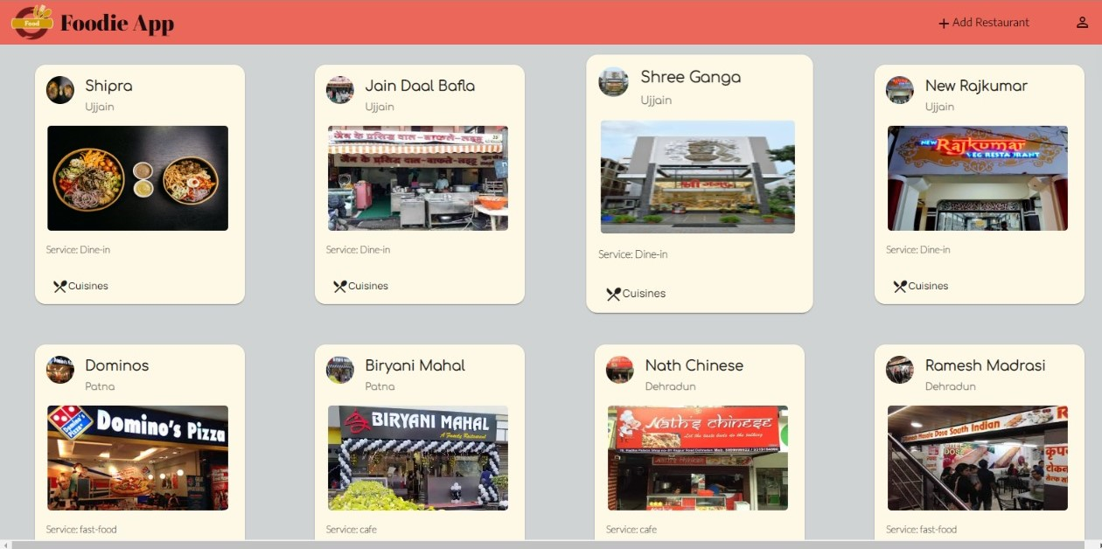
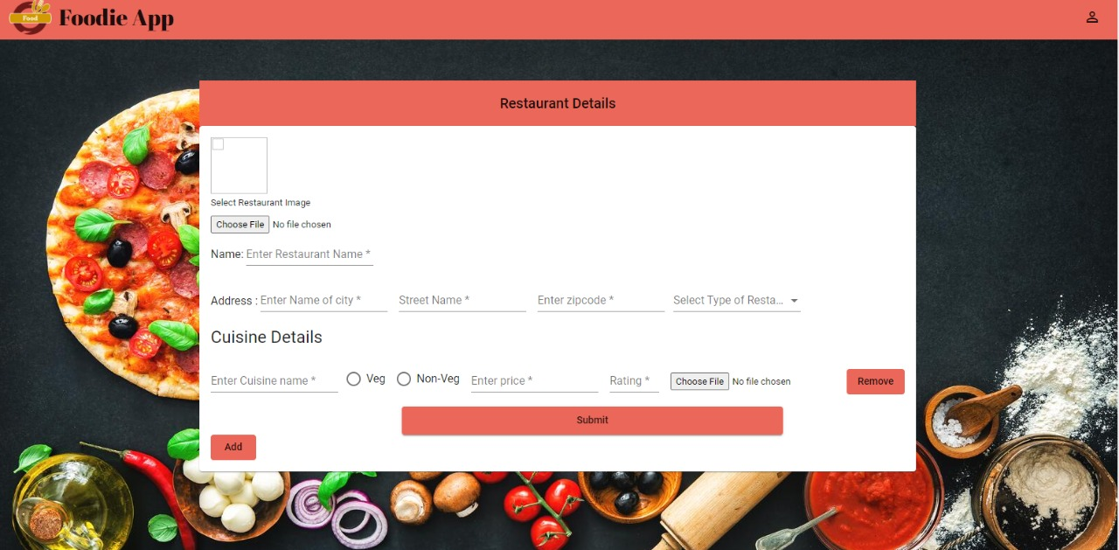
Output screenshots

Slide 17
Future Scope
Order Functionality

Slide 18
Project walkthrough

Slide 19
Question & Answer / Feedback

Slide 20


